Slide 1

Does weather affect The traffic?
Devika Ashwathappa
Sherry Javed
Matthew Belevski

Slide 2
Goal
Our goal was to determine whether the weather affects peak hour traffic either in the mornings or afternoon
Comparing traffic volume to the rainfall (mm)
Also comparing max temp of the day to traffic volume
Hypothesis is that traffic is affected by weather

Slide 3
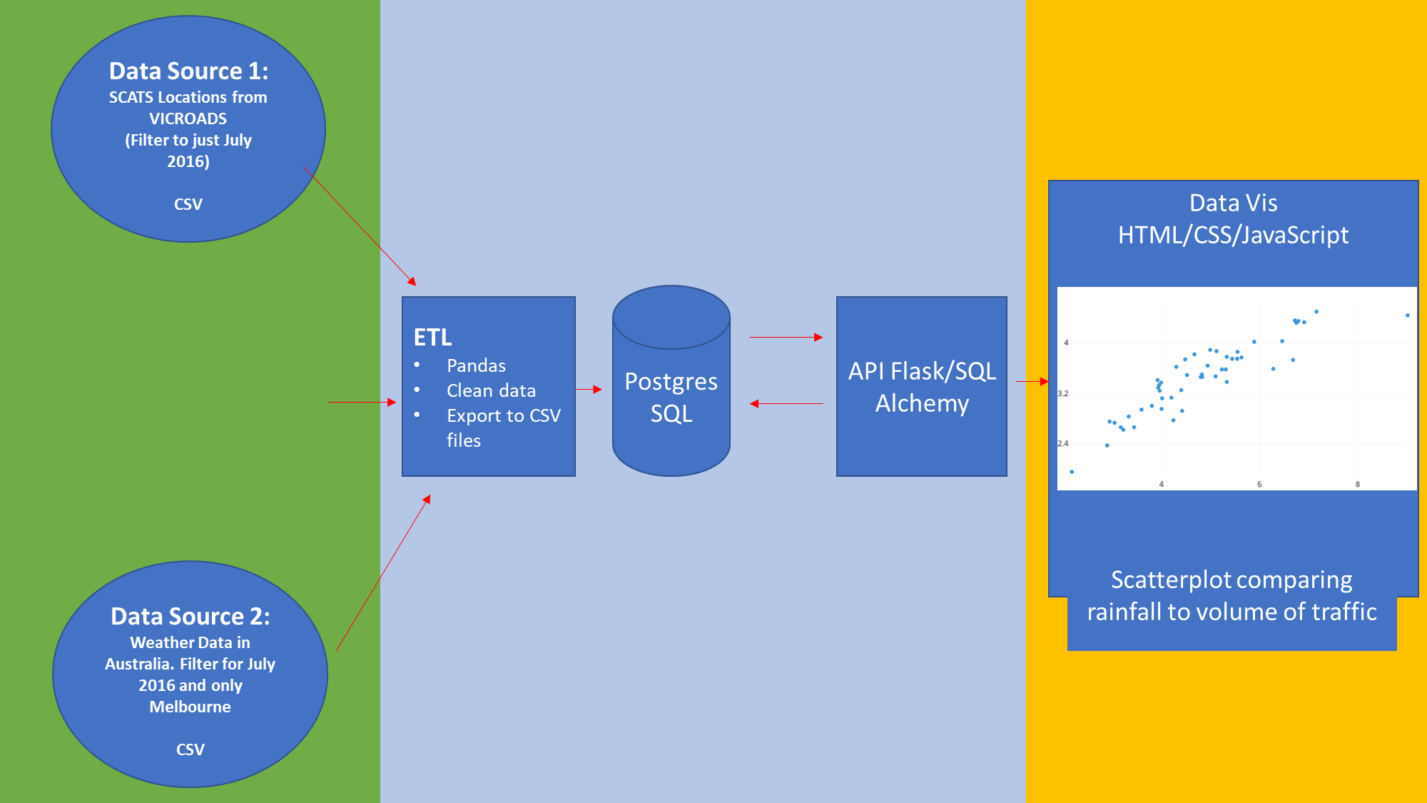
Process

Slide 4
Data sources
Weather Data
Dataset containing 10 years of daily weather observations for many locations across Australia
Selected July 2016
Use of Rainfall (mm) and Max Temp (Degrees Celsius)
Data originally sourced from Bureau of Meteorology
Traffic Signal Volume Data – VIC Data
Displays the volume of traffic in regions around Melbourne
Use of SCATS sites from Vic Roads. Traffic intersections with sensors to count the number of vehicles
Selected July 2016
Data broken down into 15 minute intervals
“AM Peak Traffic” – 6am to 8am
“PM Peak Traffic” – 4pm to 6pm

Slide 5
ETL
Traffic Signal Volume Data – VIC Data
Use of Pandas to:
Merge data as each day had it’s own spreadsheet. 31 days of data combined for July 2016
Cleaned data and removed error code figures, replacing them as zeros as to not make assumptions
Grouped data by region
Tally the AM Peak and PM Peak by the parameters we defined
Weather dataset
Use of Pandas to:
Filter by Melbourne region
Filter by date for July 2016
Merge above datasets by date, export to csv and load into PostgreSQL

Slide 6
API Flask
Use of SQLAlchemy to connect to the PostgresSQL(Heroku) database using Python
Read in SQL Table, turning it into a DataFrame
Convert DataFrame into json file to be read by the JavaScript file of the website using an API

Slide 7
Visualisation
Hosted on Heroku
Use of d3 to read in json data from API
Plotly was used to display scatterplots comparing AM/PM Peak Volume with Rainfall or Max Temp
Website can also compare different regions data by displaying both on scatterplot
Plotly was also used to display map of region/s
https://p2test123.herokuapp.com/

